Slide 1

EE-371 : Control Systems
Lecture#36
DESIGN VIA ROOT LOCUS
9.6 Physical Realization of
Compensation
Textbook: Chapter # 09 (5th edition)
Text Book: Control Systems Engineering by Norman S. Nise 5th Edition
Instructor: Ms Neelma Naz
Class: BEE 12 C/D
School of Electrical Engineering and Computer Science
Department of Electrical Engineering

Slide 2
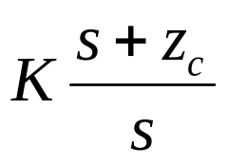
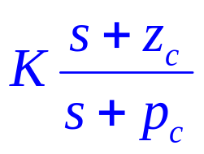
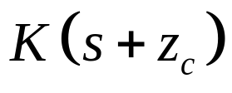
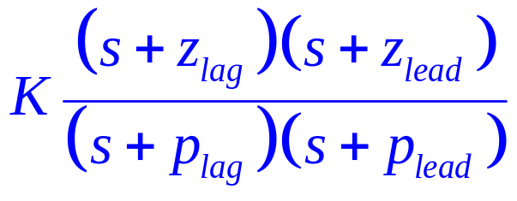
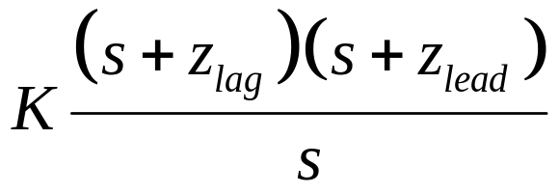
Review
PI Controller
Lag Compensator
PD Controller
Lead Compensator
PID Controller
Lag-Lead Compensator

Slide 3
Active-Circuit Realization

Slide 4
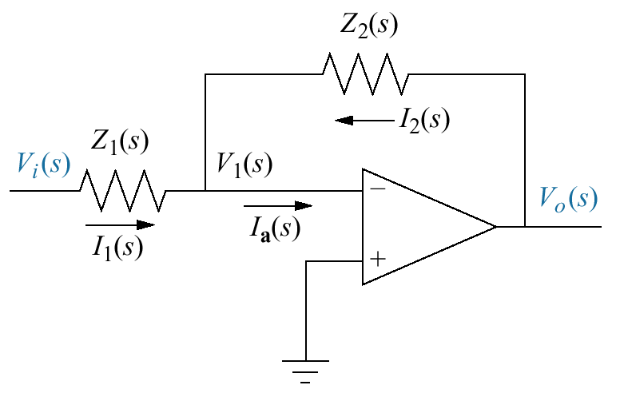
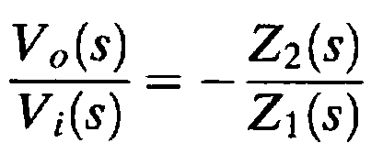
By judicious choice of Z₁(s) and Z₂(s),
the circuit can be used as a building block
to implement the controllers

Slide 5
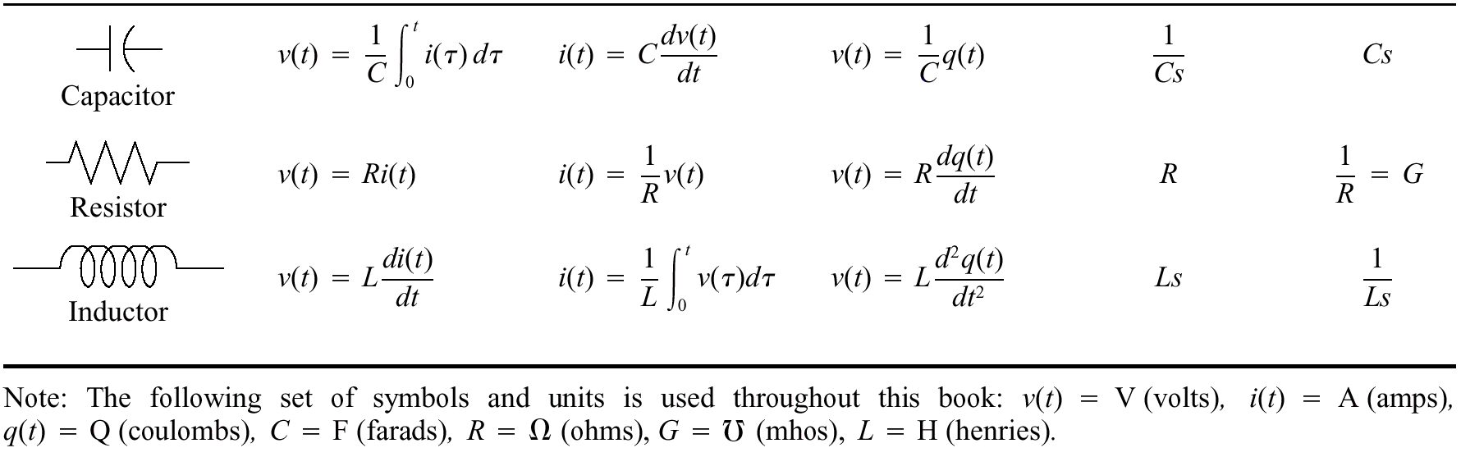
Table 2.3

Slide 6
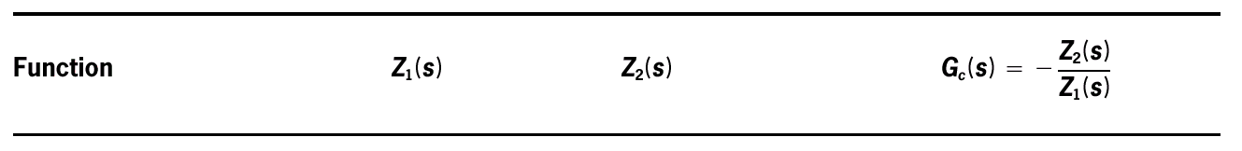
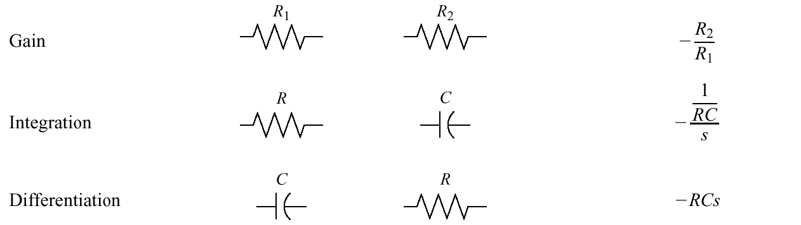
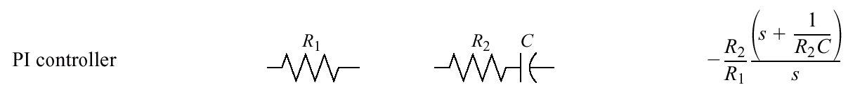
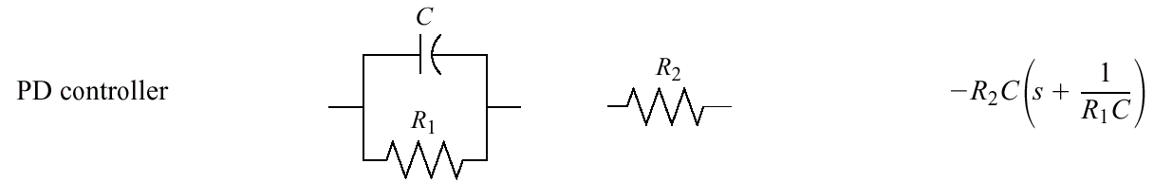
Active realization of controllers and compensators, using an operational amplifier (slide 1 of 2)
(continued next slide)

Slide 7
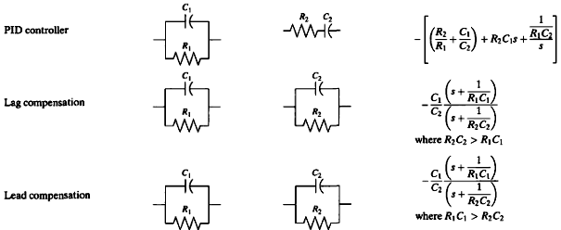
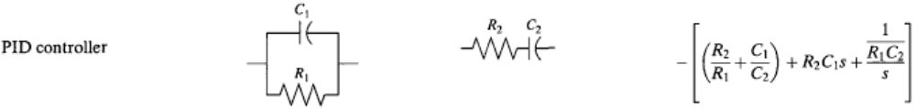
Active realization of controllers and compensators, using an operational amplifier (slide 2 of 2)

Slide 8
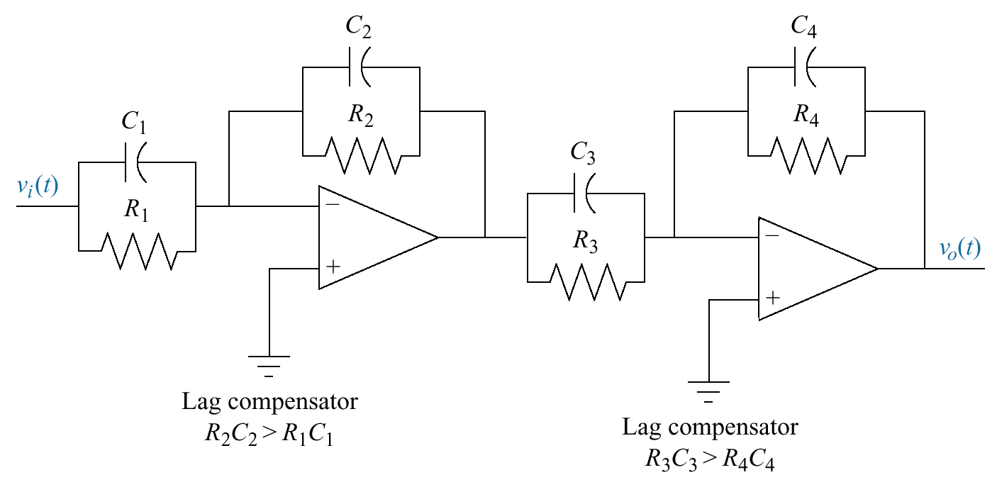
Lag-lead compensator implemented with
operational amplifiers
Lead compensator

Slide 9
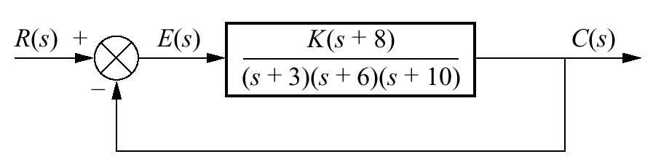
Example 9.5
PID Controller Design
PROBLEM: Given the system shown in the Figure, design a PID controller so that the system can operate with a peak time that is two-thirds that of the uncompensated system at 20% overshoot and with zero steady-state error for a step input.

Slide 10
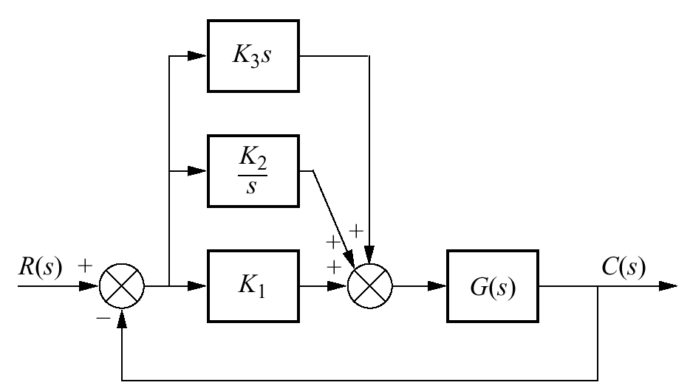
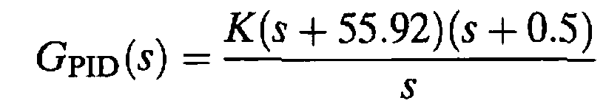
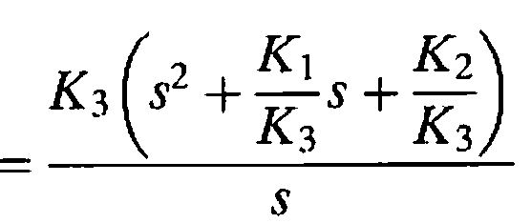
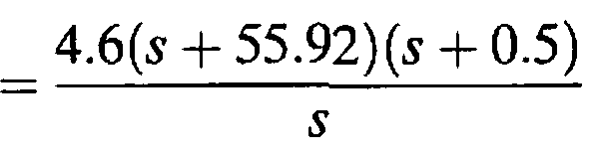
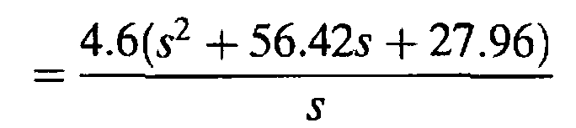
Now determine the gains, K₁,K₂, and K₃
G_{C}(s)
K₁ = 259.5,
K₂ = 128.6, and
K₃ = 4.6

Slide 11
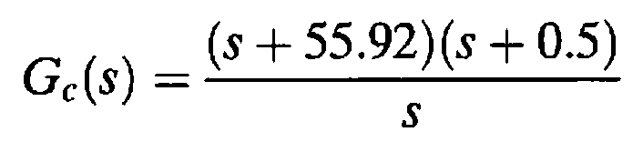
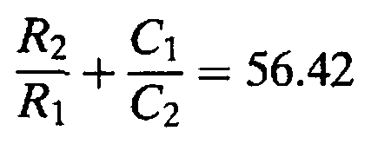
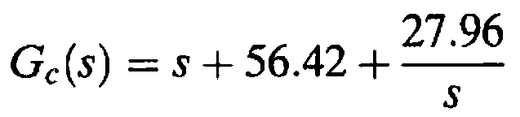
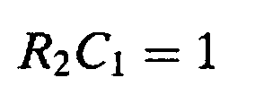
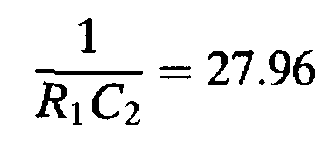
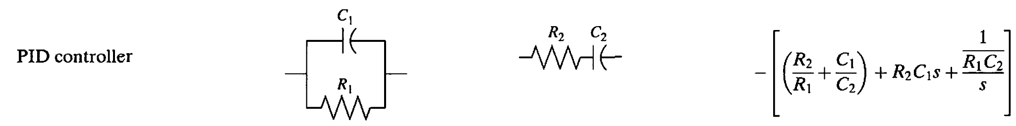
Example 9.9
implementing a PID Controller
PROBLEM: Implement the PID controller of Example 9.5.
SOLUTION: The transfer function of the PID controller is

Slide 12
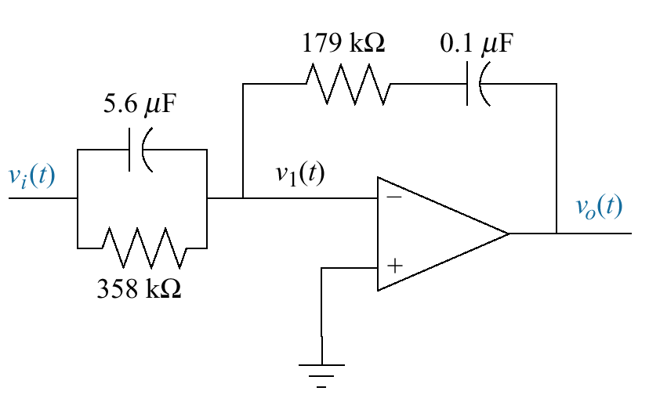
Four unknowns
and three equations
Can we find a solution ??
Arbitrarily select a practical value
for one of the elements.
Let C₂ = 0.1 μF
the remaining values are
R₁ = 357.65 kΩ
R₂ = 178.891 kΩ
C₁= 5.59 μ F

Slide 13
Passive-Circuit Realization

Slide 14
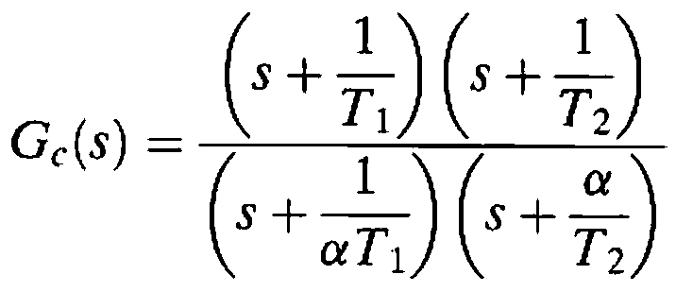
The lag-lead transfer function can be put in the form
α < 1
The terms with T₁ form the lead compensator
The terms with T₂ form the lag compensator

Slide 15
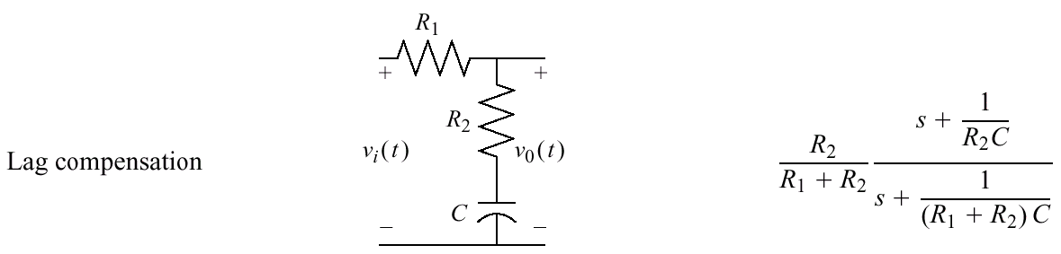
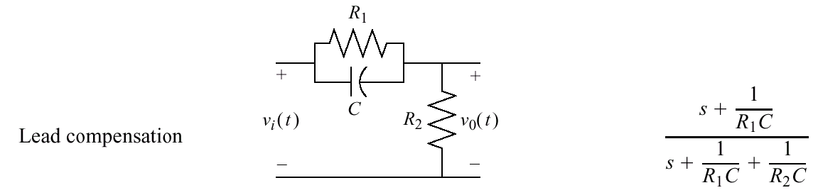
Passive realization of compensators
(slide 1 of 2)

Slide 16
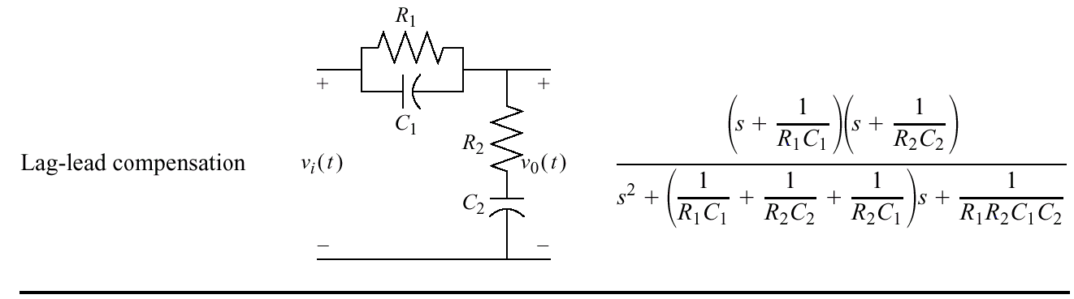
Passive realization of compensators
(slide 2 of 2)

Slide 17
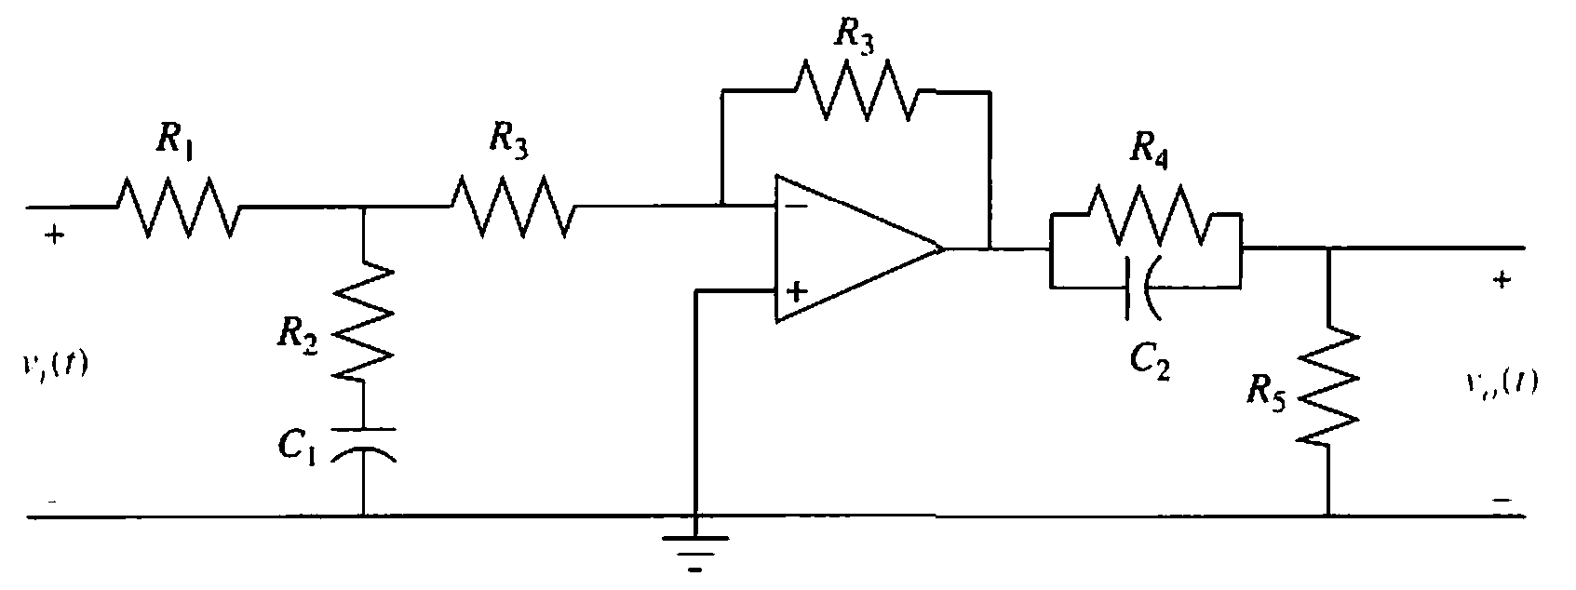
Lag-lead compensator implemented with cascaded lag and lead networks with isolation

Slide 18
Home Assignment
Case Studies
Antenna Control:
Lag-Lead Compensation
Unmanned Free Swimming Submersible (UFSS) Vehicle:
Lead and Feedback Compensation

Slide 19

???

